Slide 1
AWS Architecture Icons
Release 7.0-2020.09.11

Slide 2
Release 7.0-2020.09.11: What’s new?
Hello! We got a makeover.
We have created a better and simpler experience for everyone who uses this ppt. Here are some things we updated.
We only have one Architecture Icon per service which works in both light & dark backgrounds.
All Architecture icons have been updated to be pixel perfect, which align to an 8 pixel grid and optimize its performance on the web.
We established a grid so that all icons line-up perfectly and no longer jump around from slide to slide.
We double-checked all services, resources, instances and IoT to make sure we have the correct naming convention.
We moved Architecture and resource icons over to the new category – Containers.
The intention of this update is to utilize only one ppt. for reference. As for the icons, we strongly encourage you to download the assets separately so you can get the full suite of assets.
What’s included in the full suite?
All Architecture Icons (in svg, png and png@5x resolution)
All Resource Icons for Light Background (in svg, png and png@5x resolution)
All Resource Icons for Dark Background (in svg, png and png@5x resolution)

Slide 3
Release 7.0-2020.09.11: What’s new?
For the latest deck, asset packages, or resources, visit the AWS Architecture Center: https://aws.amazon.com/architecture/icons/
Containers Category (slide 57)
AWS CodeArtifact (slide 72)
AWS Chatbot (slide 96)
Amazon EventBridge Rule / resource icon (slide 37)
Cloudwatch Logs / resource icon (slide 91)
Amazon S3 Replication / resource icon (slide 130)
Amazon S3 Replication Time Control / resource icon (slide 130)
Amazon RDS Proxy / resource icon (slide 68)
Amazon RDS Proxy Alternate / resource icon (slide 68)
AWS Data Exchange (slide 34)
TorchServe (slide 89)
AWS Backint Agent (slide 96)
Amazon Snowcone (slide 129)
Amazon Lumberyard (slide 76)
R6g Instance / resource icon (slide 50)
M6g Instance / resource icon (slide 50)
C6g Instance / resource icon (slide 50)
Mesh / resource icon (slide 112)
Virtual node / resource icon (slide 112)
Virtual router / resource icon (slide 112)
Virtual service / resource icon (slide 112)
Service / resource icon (slide 112)
Namespace / resource icon (slide 112)
Resource / resource icon (slide 112)
Gateway / resource icon (slide 112)
Virtual gateway / resource icon (slide 112)

Slide 4
Contents
Introduction
System
Guidelines
Examples
Elements

Slide 5
Introduction
About the deck, and guidance for getting started

Slide 6






About AWS Architecture Icons
Architecture diagrams are a great way to communicate your design, deployment, and topology.
In this deck, you will find an official collection of AWS service icons, resources, and other tools to help you build customer-focused and consistent AWS Architecture diagrams.
Customers and partners are permitted by AWS to use the icons to create architecture diagrams. They are designed to be simple so that you can easily incorporate them in your diagrams and put them in your whitepapers, presentations, datasheets, posters, or any technical material you like.
AWS Cloud
Availability Zone 1
Availability Zone 2
VPC
NAT gateway
Amazon EC2 Auto Scaling
NAT gateway
Auto Scaling group
Instance
Instance
Auto Scaling group
Instance
Instance

Slide 7
Before you begin:
1
Check for the latest deck update
Download the latest deck from the
AWS Architecture Center.
2
Read the guidelines
For specific element guidance and best practices, see the guidelines
3
When in doubt, see the examples
For completed diagrams, jump to the example pages. If you’re having trouble with a particular layout or object,use these as a blueprint.

Slide 8
System
An all-up look at the diagram system

Slide 9




System elements
AWS Cloud
Groups
Arrows
Service icons
Show the connection between multiple services or resources
Describe a flow of information or connect different parts of a diagram
Represent an AWS service
Resource icons
General resource icons
Represent an AWS service resource
Apply to multiple services or categories

Slide 10
System elements
Group icon
AWS Cloud
Availability Zone 1
Availability Zone 2
Layered groups
VPC
Service icon
NAT gateway
Amazon EC2 Auto Scaling
NAT gateway
Auto Scaling group
Instance
Instance
Auto Scaling group
Resource icon
Instance
Instance

Slide 11
Guidelines
Diagram and element guidance

Slide 12
Building a diagram
Choose your deck style The architecture deck is available for both light and dark backgrounds. Determine which best fits your need–light backgrounds tend to be used on the web, whereas dark backgrounds are used for in-person presentations or slide decks.
Start with the structure Locate the groups to use for the underlying structure of your diagram.
Add service and resource icons Navigate to the category of your desired service icon or resource, or use the search capability to locate it. Then, copy and paste it into your diagram.
Add other steps Does your diagram include external users or devices? Use resources to add depth or context to your diagram.
Connect the steps Use the preset arrows to connect your steps and describe a workflow.

Slide 13
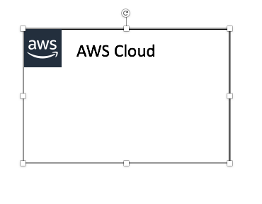

Groups
Each group consists of an icon and a label. Colors and lines help differentiate groups to make it easier for the user to read a diagram at a glance. Some groups cross multiple other groups, such as Auto Scaling, whereas others are meant to layer inside one another, such as a VPC and subnets.
Resizing groups
Use the bottom-right corner of a group box to stretch or collapse to your desired size.
Layering groups
When you have groups within groups, each inner group should have about 0.05” buffer on each side.
DO:
Hold Shift down while resizing an icon to maintain a square.
Use a generic group type if the presets do not suit your needs.
VPC
Public subnet
DON’T:
Create new group icons.

Slide 14

Icons
Primary service and resource icons are designed to be used on both dark and light backgrounds. Alternate service icons are specific to a background type. All icons may be renamed to better fit your use case (see slide 15 for more information).
Resizing icons
All icons in this deck are SVGs, allowing them to be scaled up or down depending on the diagram. To preserve icon integrity, be sure to hold down Shift while resizing.
DO:
Hold Shift down while resizing.
Change the resource icon text color when using a dark background.
Use the alternate light-bg service icon when appropriate.
DON’T:
Crop service icons.
Flip or rotate icons.
Change icon shapes.

Slide 15
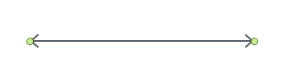
Arrows
Use arrows or lines to connect parts of a diagram or to show a workflow.
Use preset arrows
Copy the preset arrows into your diagram to maintain the correct formatting. To edit, click on the arrow and hold down Shift.
Create new arrows
Preset arrows use the “Open Arrow” in Size 4.
When in doubt, use the default
If the arrow shape that you need is not available in the sample arrows, use the default arrows.
DO:
Use the preset arrow provided in the Elements section.
Use straight lines and right angles to connect objects.
Default Arrow
+ Open Arrow
+ Size 4
DON’T:
Create diagonal lines.
Use anything beside preset or default arrows.
Hold Shift

Slide 16

Text boxes
Service and icon names are separated from the icon itself to allow for adjustment or abbreviation. You may change the size or color of the text, or use the short form of the service name if necessary.
Name wrapping and line breaks
AWS service names should fit on one or two lines. AWS or Amazon should always be accompanied by the service name. Lines should never break mid-word.
Short forms
To save space when using a service multiple times in a diagram, you may use the short service forms instead of the full name. For example, Amazon ES.
DO:
Modify color or text size if necessary.
Break a line after the second word in the service name.
Amazon Elasticsearch Service
Amazon
Elasticsearch Service
Amazon
Elastic-
search Service
DON’T:
Amazon should be on the same line as the first word in the service name.
Use short forms without first mentioning the full service name somewhere in the document.
Duplicate short forms for different services, such as ELB for Elastic Beanstalk and Elastic Load Balancing.
Break a line in the middle of a word.
Lines should never break mid-word, and should fit on two lines max.

Slide 17
Examples
The system in action

Slide 18



Example: Git to S3 Webhooks
AWS Cloud
Amazon S3
SSH key bucket
Git push
Third-party Git repository
Git webhook
Git users
AWS KMS key
AWS Lambda
AWS Lambda
Amazon S3 output bucket

Slide 19

Example: Chef Automate Architecture on AWS
AWS Cloud
Availability Zone
VPC
Internet gateway
Chef Knife is used to upload cookbooks
Knife is used to bootstrap and communicate with nodes
Chef-client processes run-list
Public subnet
1
Chef Automate
3
2
Chef workstation (local Chef repo)
Chef node
10.0.0.0/19
10.0.0.0/16

Slide 20
Elements
Resources to use when building your diagram

Slide 21
Icon categories
Click a category to jump to slide (must be in Presentation mode)
General Resources
Analytics
Application Integration
AR & VR
AWS Cost Management
Blockchain
Business Applications
Compute
Containers
Customer Enablement
Customer Engagement
Database
Developer Tools
End User Computing
Game Tech
Internet of Things
Machine Learning
Management & Governance
Media Services
Migration & Transfer
Mobile
Networking & Content Delivery
Quantum Technologies
Robotics
Satellite
Security, Identity, & Compliance
Storage

Slide 22
General Resources

Slide 23








Groups – Light Backgrounds
AWS Cloud
AWS Cloud
Region
Availability Zone
Security group
Auto Scaling group
VPC
Private subnet
Public subnet
Server contents
Corporate
data center
Elastic Beanstalk container
EC2 instance contents
Spot Fleet
AWS Step Functions workflow
Generic group
Generic group

Slide 24













Groups – Dark Backgrounds
AWS Cloud
AWS Cloud
Region
Availability Zone
Security group
Auto Scaling group
VPC
Private subnet
Public subnet
Server contents
Corporate
data center
Elastic Beanstalk container
EC2 instance contents
Spot Fleet
AWS Step Functions workflow
Generic group
Generic group

Slide 25
Arrows – Light Backgrounds

Slide 26
Arrows – Dark Backgrounds

Slide 27




















General Icons – Light Backgrounds
3/3
AWS Marketplace
Client
Disk
Forums
Generic database
Internet
Internet alt1
Internet alt2
Mobile client
Firewall
Email
Multimedia
Office building
SAML token
SSL padlock
Tape storage
Traditional server
User
Users
Toolkit
SDK

Slide 28
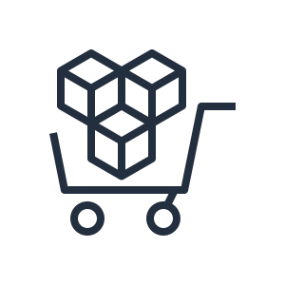




















General Icons – Dark Backgrounds
4/4
AWS Marketplace
Client
Disk
Forums
Generic database
Internet
Internet alt1
Internet alt2
Mobile client
Firewall
Email
Multimedia
Office building
SAML token
SSL padlock
Tape storage
Traditional server
User
Users
Toolkit
SDK

Slide 29

Analytics
STANDARD CATEGORY ICON

Slide 30







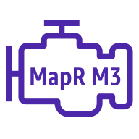


Analytics
1/5
Amazon CloudSearch
Amazon EMR
Amazon Kinesis
Search documents
HDFS
cluster
Cluster
EMR engine
EMR engine
mapR M3
EMR engine
mapR M5
EMR engine
mapR M7

Slide 31




Analytics
2/5
Amazon Kinesis Video Streams
Amazon Kinesis Data Streams
Amazon Kinesis Data Firehose
Amazon Kinesis Data Analytics

Slide 32








Analytics
3/5
AWS Glue
Amazon Athena
Amazon Elasticsearch Service
Amazon Redshift
Crawler
Dense compute node
AWS glue data catalog
Dense storage node

Slide 33





Analytics
4/5
Amazon QuickSight
AWS Lake Formation
AWS Data Pipeline
Amazon Managed Streaming for Kafka
Data lake

Slide 34

Analytics
5/5
AWS Data Exchange

Slide 35

Application Integration
STANDARD CATEGORY ICON

Slide 36



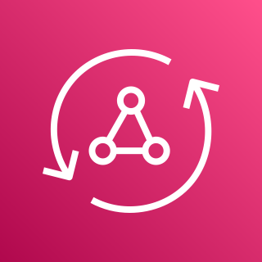





Application Integration
1/3
Amazon Simple
Notification Service
Amazon Simple Queue Service
Amazon MQ
AWS AppSync
Email notification
Message
HTTP notification
Queue
Topic

Slide 37









Application Integration
2/3
AWS Step Functions
Amazon EventBridge
AWS Console Mobile Application
AWS Express Workflows
Event
Default
event bus
Custom
event bus
SaaS
event bus
Rule

Slide 38

Application Integration
3/3
AWS AppFlow

Slide 39

AR & VR
STANDARD CATEGORY ICON

Slide 40
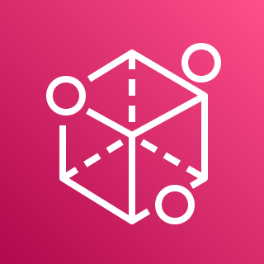
AR & VR
1/1
Amazon Sumerian

Slide 41

AWS Cost Management
STANDARD CATEGORY ICON

Slide 42




AWS Cost Management
1/2
AWS Budgets
AWS Cost & Usage Report
AWS Cost Explorer
Reserved Instance Reporting

Slide 43

AWS Cost Management
2/2
Savings Plans

Slide 44

Blockchain
STANDARD CATEGORY ICON

Slide 45



Blockchain
1/1
Amazon Managed Blockchain
Amazon Quantum Ledger Database
Blockchain

Slide 46

Business Applications
STANDARD CATEGORY ICON

Slide 47



Business Applications
1/1
Alexa for Business
Amazon Chime
Amazon WorkMail

Slide 48

Compute
STANDARD CATEGORY ICON

Slide 49























Compute
1/8
Resource Icons
Amazon EC2
AMI
Auto
scaling
Elastic IP address
Rescue
Instance
A1 instance
M4 instance
R5a instance
Z1d instance
H1 instance
Instances
T3 instance
C5 instance
R4 instance
P3 instance
I3 instance
Spot instance
T2 instance
C5n instance
X1e instance
P2 instance
D2 instance

Slide 50













Compute
2/8
Amazon EC2
DB instance
M5 instance
C4 instance
X1 instance
High memory instance
Instance with
CloudWatch
M5a instance
R5 instance
G3 instance
F1 instance
M6g instance
R6g instance
C6g instance

Slide 51







Compute
3/8
AWS Elastic Beanstalk
AWS Lambda
Amazon Lightsail
Amazon EC2 Auto Scaling
Deployment
Lambda function
Application

Slide 52



Compute
4/8
AWS Batch
AWS Outposts
AWS Serverless Application Repository

Slide 53




Compute
5/8
Vmware Cloud on AWS
AWS Thinkbox Deadline
AWS Thinkbox XMesh
AWS Thinkbox Frost

Slide 54




Compute
6/8
AWS Thinkbox Krakatoa
AWS Thinkbox Sequoia
AWS Thinkbox Stoke
AWS Wavelength

Slide 55




Compute
7/8
AWS Compute Optimizer
AWS Local Zones
EC2 Image Builder
Bottlerocket

Slide 56

Compute
8/8
AWS Parallel Cluster

Slide 57

Containers
STANDARD CATEGORY ICON

Slide 58











Containers
1/1
Amazon Elastic
Container Kubernetes
Amazon Elastic Container Registry
Amazon Elastic Container Service
AWS Fargate
Registry
Container 1
Container 2
Image
Container 3
Service
Task

Slide 59

Customer Enablement
STANDARD CATEGORY ICON

Slide 60




Customer Enablement
1/1
AWS IQ
AWS Managed Services
AWS Professional Services
AWS Support

Slide 61

Customer Engagement
STANDARD CATEGORY ICON

Slide 62




Customer Engagement
1/1
Amazon Connect
Amazon Pinpoint
Amazon Simple Email Service
Email

Slide 63

Database
STANDARD CATEGORY ICON

Slide 64

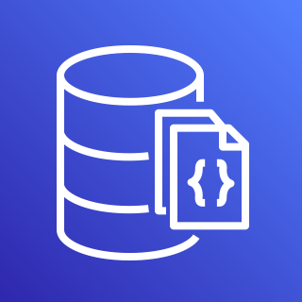








Database
1/5
Amazon Aurora
Amazon DocumentDB (with MongoDB compatibility)
Amazon DynamoDB
Attribute
Items
Amazon DynamoDB Accelerator (DAX)
Item
Table
Attributes
Global secondary
index

Slide 65







Database
2/5
Amazon Redshift
AWS Database
Migration Service
Amazon Neptune
Amazon Quantum Ledger Database
Dense compute node
Database migration workflow/job
Dense storage node

Slide 66







Database
3/5
Amazon RDS
Amazon RDS on VMware
Amazon Timestream
Amazon ElastiCache
Cache node
ElastiCache
for Redis
ElastiCache for Memcached

Slide 67

Database
4/5
Amazon Keyspaces

Slide 68











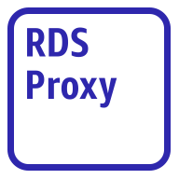
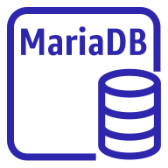



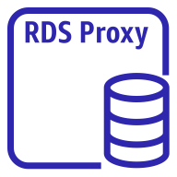
Database
5/5
Amazon Aurora instance
Amazon Aurora instance alternate
Amazon RDS instance
Amazon RDS
instance alternate
MySQL
instance
MySQL
instance alternate
Oracle
instance
Oracle
Instance alternate
Postgre SQL instance
Postgre SQL
instance alternate
PIOPS
Amazon RDS
proxy alternate
MariaDB instance
MariaDB instance alternate
SQL server
instance
SQL server
Instance alternate
Amazon RDS
proxy

Slide 69

Developer Tools
STANDARD CATEGORY ICON

Slide 70





Developer Tools
1/3
AWS Cloud9
AWS CodeBuild
AWS CodeCommit
AWS CodeDeploy
AWS Cloud9

Slide 71



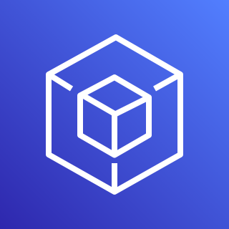
Developer Tools
2/3
AWS CodePipeline
AWS CodeStar
AWS Command Line Interface
AWS Tools and SDKs

Slide 72

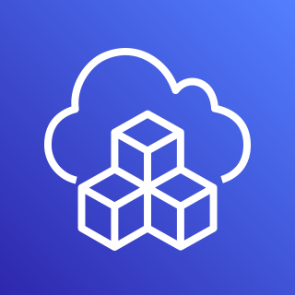

Developer Tools
3/3
AWS X-Ray
AWS Cloud Development Kit
AWS CodeArtifact

Slide 73

End User Computing
STANDARD CATEGORY ICON

Slide 74

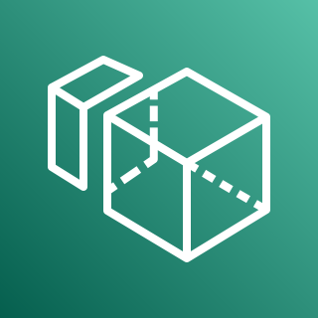


End User Computing
1/1
Amazon AppStream 2.0
Amazon WorkSpaces
Amazon WorkLink
Amazon WorkDocs

Slide 75

Game Tech
STANDARD CATEGORY ICON

Slide 76


Game Tech
1/1
Amazon GameLift
Amazon Lumberyard

Slide 77

Internet of Things
STANDARD CATEGORY ICON

Slide 78









Internet of Things
1/5
Amazon FreeRTOS
AWS loT 1-Click
AWS loT Analytics
AWS loT Button
Channel
Data set
Pipeline
Notebook
Data store

Slide 79





Internet of Things
2/5
AWS loT Core
AWS loT Device Defender
AWS loT Device Management
AWS loT Events
loT device jobs

Slide 80




Internet of Things
3/5
AWS loT Greengrass
AWS loT SiteWise
AWS loT Things Graph
Connector

Slide 81

























Internet of Things
4/5
loT action
loT actuator
loT certificate
loT desired state
loT hardware board
loT HTTP protocol
loT HTTP/2 protocol
loT MQTT protocol
loT policy
loT reported state
loT rule
loT sensor
loT servo
loT shadow
loT simulator
loT topic
Alexa skill
Alexa voice service
Alexa-enabled device
Echo
Fire TV
Fire TV stick
Lambda function
Over-the-air update
Device gateway

Slide 82
















Internet of Things
5/5
loT thing bank
loT thing bicycle
loT thing camera
loT thing car
loT thing cart
loT thing coffee pot
loT thing door lock
loT thing factory
loT thing generic
loT thing house
loT thing lightbulb
loT thing travel
loT thing medical emergency
loT thing police emergency
loT thing utility
loT thing windfarm

Slide 83

Machine Learning
STANDARD CATEGORY ICON

Slide 84




Machine Learning
1/6
Amazon Comprehend
Amazon Elastic Inference
Amazon Forecast
Amazon Lex

Slide 85









Machine Learning
2/6
Amazon Personalize
Amazon Polly
Amazon Rekognition
Amazon SageMaker
Amazon Rekognition image
Notebook
Amazon Rekognition video
Model
Train

Slide 86



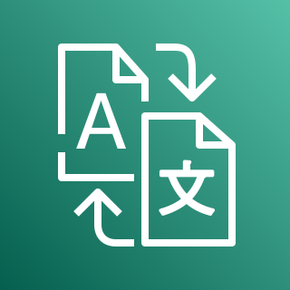
Machine Learning
3/6
Amazon SageMaker Ground Truth
Amazon Textract
Amazon Transcribe
Amazon Translate

Slide 87




Machine Learning
4/6
AWS Deep Learning AMIs
AWS Deep Learning Containers
AWS DeepLens
AWS DeepRacer

Slide 88



Machine Learning
5/6
Apache MXNet on AWS
TensorFlow on AWS
AWS DeepComposer
Amazon Augmented AI

Slide 89




Machine Learning
6/6
Amazon Fraud Detector
Amazon Kendra
Amazon CodeGuru
TorchServe

Slide 90

Management & Governance
STANDARD CATEGORY ICON

Slide 91












Management & Governance
1/7
Amazon CloudWatch
AWS Auto Scaling
AWS CloudFormation
AWS CloudTrail
Alarm
Rule
Change set
Stack
Event (event-based)
Event (time-based)
Template
Logs

Slide 92




Management & Governance
2/7
AWS Command Line Interface
AWS Config
AWS License Manager
AWS Managed Services

Slide 93











Management & Governance
3/7
AWS Management Console
AWS OpsWorks
AWS Personal Health Dashboard
Apps
Instances
Monitoring
Permissions
Deployments
Layers
Resources
Stack2

Slide 94











Management & Governance
4/7
AWS Service Catalog
AWS Systems Manager
Automation
Documents
Patch manger
Parameter store
OpsCenter
Inventory
Maintenance windows
State manager
Run command

Slide 95








Management & Governance
5/7
AWS Trusted Advisor
AWS Well-Architected Tool
AWS Control Tower
Checklist
cost
Checklist
performance
Checklist
security
Checklist
fault tolerant
Checklist

Slide 96
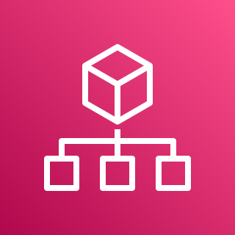





Management & Governance
6/7
AWS Organizations
AWS AppConfig
AWS Chatbot
AWS Backint Agent
Account
Organizational unit

Slide 97

Management & Governance
7/7
Application Auto Scaling

Slide 98

Media Services
STANDARD CATEGORY ICON

Slide 99




Media Services
1/4
Amazon Elastic Transcoder
Amazon Kinesis Video Stream
AWS Elemental MediaConnect
AWS Elemental MediaConvert

Slide 100




Media Services
2/4
AWS Elemental MediaLive
AWS Elemental MediaPackage
AWS Elemental MediaStore
AWS Elemental MediaTailor

Slide 101

Media Services
3/4
AWS Elemental Conductor
AWS Elemental Delta
AWS Elemental Live
AWS Elemental Server

Slide 102


Media Services
4/4
Amazon Interactive Video
AWS Elemental Link

Slide 103

Migration & Transfer
STANDARD CATEGORY ICON

Slide 104





Migration & Transfer
1/2
AWS Application Discovery Service
AWS Database Migration Service
AWS DataSync
AWS Migration Hub
Agent

Slide 105






Migration & Transfer
2/2
AWS Server Migration Service
AWS Transfer Family
CloudEndure Migration
AWS FTPS
AWS SFTP
AWS FTP

Slide 106

Mobile
STANDARD CATEGORY ICON

Slide 107



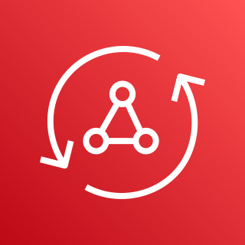

Mobile
1/2
Amazon API Gateway
Amazon Pinpoint
AWS Amplify
AWS AppSync
Endpoint

Slide 108

Mobile
2/2
AWS Device Farm

Slide 109

Networking & Content Delivery
STANDARD CATEGORY ICON

Slide 110








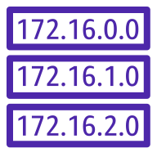

Networking & Content Delivery
1/4
Amazon API Gateway
Amazon CloudFront
Amazon Route 53
AWS PrivateLink
Endpoint
Download distribution
Hosted zone
Edge location
Route table
Streaming distribution

Slide 111














Networking & Content Delivery
2/4
Amazon VPC
Customer gateway
Internet gateway
VPN gateway
Flow logs
Endpoints
Router
Traffic mirroring
NAT gateway
Elastic network interface
Elastic network adapter
Network access control list
VPN connection
Peering connection

Slide 112













Networking & Content Delivery
3/4
AWS App Mesh
AWS Cloud Map
AWS Direct Connect
AWS Global Accelerator
Mesh
Virtual
gateway
Service
Gateway
Virtual node
Virtual router
Namespace
Virtual service
Resource

Slide 113







Networking & Content Delivery
4/4
AWS Transit Gateway
AWS Client VPN
AWS Site-to-Site VPN
Elastic Load Balancing
Application load balancer
Classic load balancer
Network load balancer

Slide 114

Quantum Technologies
STANDARD CATEGORY ICON

Slide 115

Quantum Technologies
1/1
Amazon Braket

Slide 116

Robotics
STANDARD CATEGORY ICON

Slide 117





Robotics
1/1
AWS RoboMaker
Cloud extensions ROS
Development environment
Fleet
management
Simulation

Slide 118

Satellite
STANDARD CATEGORY ICON

Slide 119

Satellite
1/1
AWS Ground Station

Slide 120

Security, Identity, & Compliance
STANDARD CATEGORY ICON

Slide 121





Security, Identity, & Compliance
1/5
Amazon Cloud Directory
Amazon Cognito
Amazon GuardDuty
Amazon Inspector
Agent

Slide 122





Security, Identity, & Compliance
2/5
Amazon Macie
AWS Artifact
AWS Certificate Manager
AWS CloudHSM
Certificate authority

Slide 123















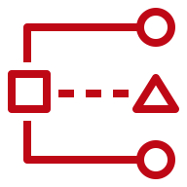
Security, Identity, & Compliance
3/5
AWS Directory Service
AWS Firewall Manager
AWS Identity & Access Management
Simple AD
Add-on
Permissions
MFA token
AWS STS
AWS STS (alternate)
Long-term security
credential
AD Connector
Encrypted data
Data encryption key
AWS Managed Microsoft AD
Role
AWS IAM Access analyzer

Slide 124






Security, Identity, & Compliance
4/5
AWS Key Management Service
AWS Secrets Manager
AWS Security Hub
AWS Shield
Finding
AWS shield advanced

Slide 125





Security, Identity, & Compliance
5/5
AWS Single Sign-On
AWS WAF
Amazon Detective
AWS Resource
Access Manager
Filtering rule

Slide 126

Storage
STANDARD CATEGORY ICON

Slide 127
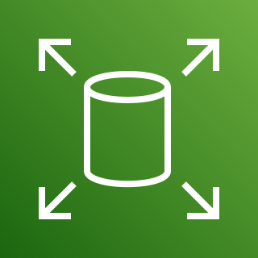













Storage
1/4
Amazon Elastic Block Store
Amazon Elastic File System
AWS Backup
AWS Storage Gateway
Snapshot
File system
Non-cached
volume
Cached
volume
Volume
Virtual tape
library
Tape
gateway
Multiple volumes
Volume
gateway
File
gateway

Slide 128



Storage
2/4
Amazon FSx for Lustre
Amazon FSx for Windows File Server
CloudEndure Disaster Recovery
File system
File system

Slide 129

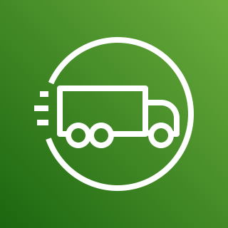



Storage
3/4
AWS Snowball Edge
AWS Snowmobile
AWS Snowball
AWS Snowcone
Snowball import-export

Slide 130

















Storage
4/4
Amazon Simple Storage Service (S3)
Amazon S3 Glacier
S3 Intelligent- Tiering
S3 Glacier
S3 Glacier Deep Archive
Vault
Archive
S3 Standard
S3 One Zone-IA
S3 Standard-IA
Bucket with
objects
Access points
VPC access points
Bucket
Replication time control
Replication
Object

